Slide 1

SUBSTANCE USE DISORDER HOUSING AND SERVICES FUNDING
Rob Dapice, Executive Director
New Hampshire Housing
NH OPIOID ABATEMENT ADVISORY COMMITTEE
August 14, 2023
NHHOUSING.ORG
Notes:
Thanks for having me today.
I’m pleased to be here to talk about New Hampshire Housing’s role in financing Substance Abuse Disorder and supportive housing.

Slide 2
WE PROMOTE, FINANCE, AND SUPPORT
HOUSING SOLUTIONS FOR THE PEOPLE OF NH
  Helped more than 55,000 families purchase their own homes
  Provided financing to create 16,000+ multifamily units
  Provided direct assistance to tens of thousands of households
  LAST YEAR, NEW HAMPSHIRE HOUSING:
  Financed 1,800+ units of multifamily rental housing
  Monitored operations of thousands of units of rental housing we financed
  Administered federally funded rental assistance for
  9,000 households statewide
  Helped 1,000 families purchase a home
Notes:
Before I get into any discussion about what we do or what we see, I like to explain what New Hampshire Housing is and why it exists.
We were Established by NH State Law in 1981 as a self-supporting public corporation
We manage a wide range of programs that advance this mission: to PROMOTE, FINANCE, and SUPPORT HOUSING SOLUTIONS FOR THE PEOPLE OF NH.
Some of those programs are funded with Federal or State dollars. However, we don’t receive any operating funds from the state. We are not state employees.
Because we serve the public and in some cases we administer public funds, our structure is designed to incorporate accountability. That’s through our board of directors
Has 9 members, appointed by the Governor.
Here are some gee-whiz numbers.
These numbers tell part of the story of the work we do and the lives that we touch, but only part of it.
Although we are a finance agency, we never lose our focus on the people we serve. That includes the people whom we’ve helped and the many who are still without a decent, affordable home.
I’m going to talk about the programs that we run in order to achieve these outcomes
Before I do that I want to highlight a theme which I think you’ll see throughout those program areas.
That theme is: we don’t do anything alone.
We don’t own or operate any property. We don’t make home loans to consumers.
Across all our divisions and program areas, we provide tools to local partners across a variety of industries in every part of the state.
This includes government agencies like HUD and the Department of Health & Human Services;
Nonprofits like (select based on audience)
Also a wide range of developers, lenders, realtors, and landlords.

Slide 3


NH HOUSING PROGRAMS
HOMEOWNERSHIP
Mortgage programs for low- & moderate-income resident, many with downpayment assistance
Financial counseling to prepare for homeownership
ASSISTED HOUSING
Moving to Work Program (HUD grant)
Landlord Incentives
NH Homeowner Assistance Fund Program
Notes:
New Hampshire Housing has responded to the state’s housing needs in so many ways since the last time we met for this conference. If I tried to list them, we would be here all day.
Here are some highlights.
Our Homeownership Team has pivoted with speed and certainty during the most challenging and turbulent times for homeownership in over a decade.
Our Assisted Housing Division, which administers the Housing Choice Voucher program in areas of the state that aren’t served by a local housing authority, recently achieved Moving to Work designation.
We’re one of the only State Housing Authorities to receive this designation, and it means that Dee Pouliot’s team will be exempt from some of the burdensome rules governing the program specifically so we can help residents find employment and become self-sufficient.
This is a big deal. It will make a difference in the lives of the people we serve.
The Assisted Housing group has also introduced the first statewide landlord incentive program that encourages landlords to accept renters who are paying their rent with the help of a voucher.
Our Multifamily Division has stepped up with nearly 2,000 new apartment homes in the process of being created or preserved.
We’re squeezing the last drop out of all available resources to meet the moment
Including the federal Low Income Housing Tax Credit and HOME and Housing Trust Fund, plus $10 million made available through Governor Sununu’s InvestNH program.
What’s more, HALF of all grantees awarded funding last month by our partners at the Department of Business and Economic Affairs elected to have their funds administered by NH Housing.
Their choice reflects their confidence in us.
These developers know that they have a partner in NH Housing to help support them in their management of these properties as true affordable housing, rented to working class people for the next 40 years; and means that when these loans are paid back, they will fund future affordable housing initiatives.

Slide 4

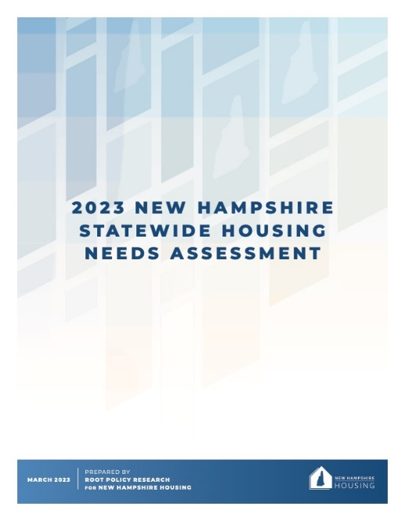

RESEARCH • PLANNING • ADVOCACY
  Housing Studies and Reports
  Annual Residential Rental Cost Survey
  Housing Advocacy/Technical Assistance and grants
  Housing Planning Reports (state & federal)
  Conferences focused on housing issues and policies
  InvestNH Municipal Planning & Zoning Grants
Notes:
INVESTNH INITIATIVE
Part of Governor Sununu’s $100 million InvestNH initiative
$5 million for grants to municipalities
Study zoning or other regulatory causes for the lack of housing at the local level
Update land use regulations in response to findings

Slide 5
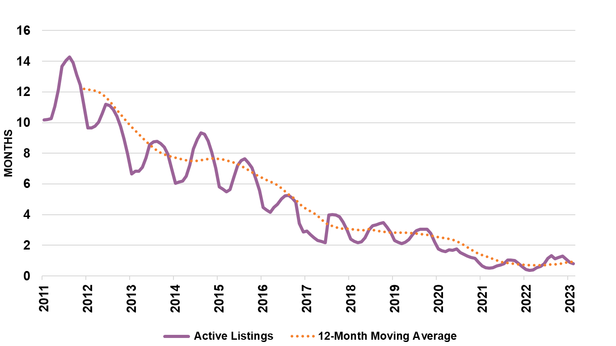
HOUSING SNAPSHOT: SINGLE-FAMILY INVENTORY
Months to absorb active listings at prior 12 months’ sales pace
Inventory shortage has the greatest impact at the lower end of the market
Less than
6 months of inventory is considered a seller’s market.
0.8 MONTHS
Source: NNEREN
Notes:
George
So, we know how renters are doing. How about prospective homebuyers?
It’s important to note what we exclude from our analysis because we are trying to view the market from the lens of a first-time homebuyer. We remove seasonal camps/cottages, interval ownership/timeshares, age-restricted properties, and properties that are described as cash only or complete tear down properties.
So, let’s see how things are looking…
On the for-sale side of the housing market, we measure supply in months of supply: how long would it take for all available homes to disappear if the market continued at the preceding 12-month’s pace of sales activity and no new units were listed.
The horizontal line is at 6 months – 6 months is a balanced market. Anything less than 6 months of inventory is a seller’s market.
Last month (February 2023), we were at 0.8 months of supply. That’s better than last February when we had only 0.4 months.
But needless to say, that’s bad! Inventory of homes available for sale is very, very low.
Low inventory, plus high home prices, coupled with rising interest rates have shut out many first-time homebuyers.

Slide 6
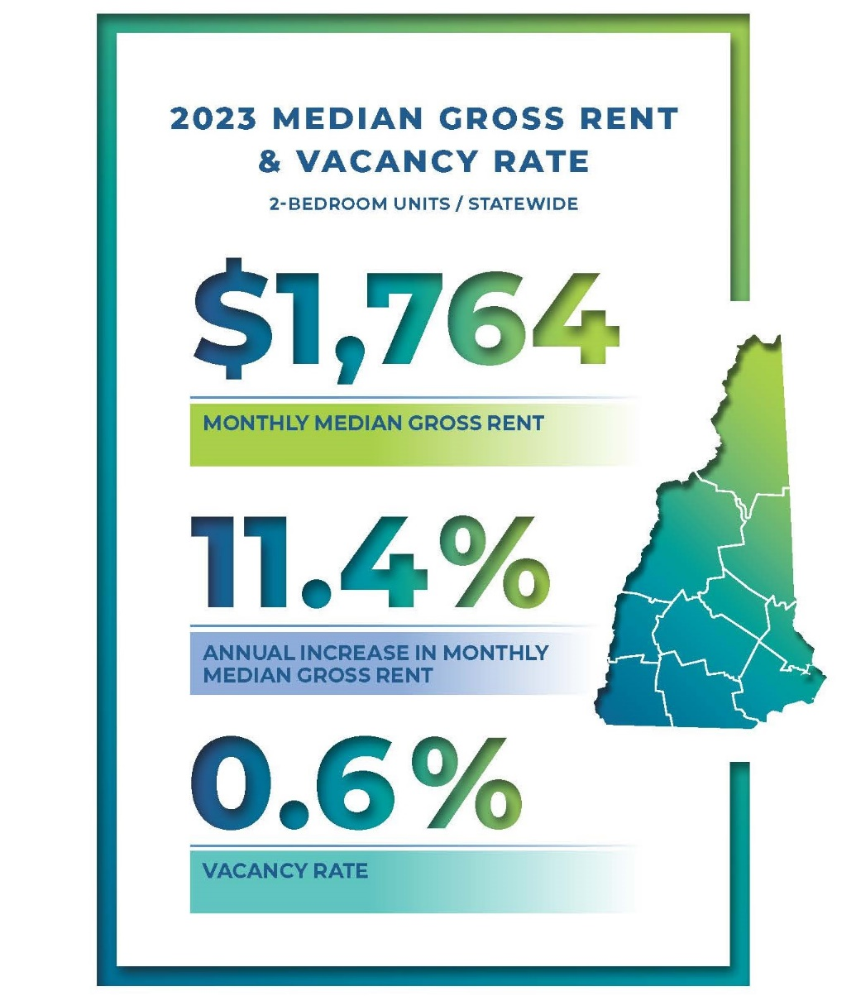
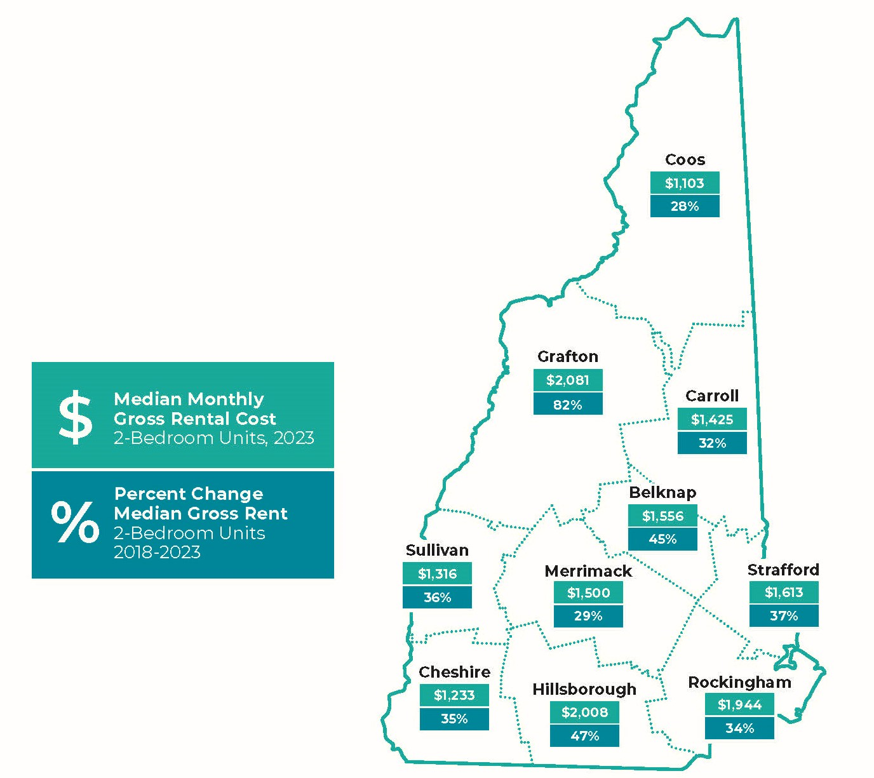
HOUSING SNAPSHOT: 2023 RENTAL COST SURVEY

Slide 7
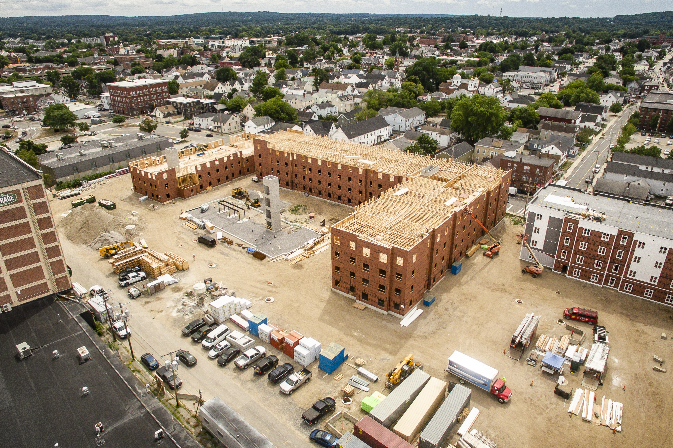
MULTIFAMILY
HOUSING PROGRAMS
We finance construction, acquisition and preservation of affordable rental housing for families, individuals of all ages, and people who need supportive housing services (substance use disorders, veterans, transitional)
Notes:
Our Multifamily Division provides below market financing to developers to construct or rehab multifamily rental housing in exchange for their commitment to rent their apartments to low or moderate income people for rents they can afford.
In FY 22, we funded 98 supportive housing units, and a total of nearly 2,000 new apartment homes that are in the process of being created or preserved.
We use a variety of tools Including the federal Low Income Housing Tax Credit and HOME and Housing Trust Fund, plus the state Affordable Housing Fund. We also have a role in administering the InvestNH program.
These affordable apartments are monitored by our staff to ensure they are well managed and maintained, and they are required to remain affordable for decades into the future.

Slide 8
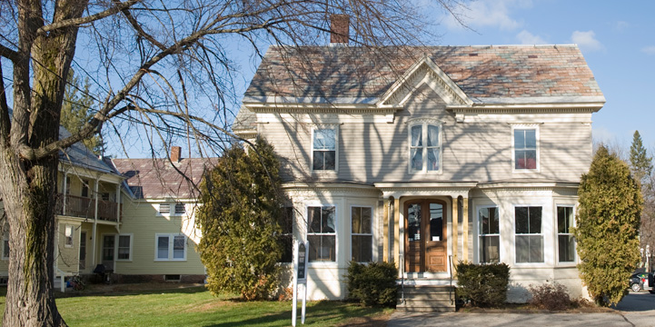
SUPPORTIVE HOUSING PROGRAM OVERVIEW
Capital funding to create supportive housing (affordable housing + supportive services)
0% interest, deferred payment loans with affordability restrictions
Funds may be used for acquisition, construction, soft costs, fees, etc.
Funds are administered through a Notice of Funding Opportunity (NOFO)
Program is governed by NH Housing rules and funding requirements
KEENE: 106 Roxbury Street
30-bed transitional housing
for individuals participating in
clinical recovery program
Notes:
Supportive Housing Program Overview
NHH provides capital funding to support the creation of supportive housing, which is affordable housing in combination with supportive services that are designed to help residents maintain their housing and live in an independent, non-institutional setting. Eligible populations include individuals with substance use disorder, persons with severe mental illness, and those who are experiencing homelessness or at-risk of homelessness.
Program supports a variety of supportive housing models and housing types, including permanent supportive housing, transitional housing, emergency housing, and recovery housing models. Unit types include apartments, single-room occupancy, and congregate facilities where residents may share bedrooms and use common area facilities.
NHH funding is in the form of a 0% deferred payment loan. NHH investment is secured by loan documents and regulatory agreements to ensure compliance with affordability and other programmatic considerations.
Funding can be used for a variety of eligible development costs, however NHH financing comes available when the project is permitted and ready to proceed with construction. Project sponsor is responsible for successfully executed necessary predevelopment activities. NHH does have pre-development loan program that can be used to support predevelopment costs that are necessary in order for a project to be shovel ready.
Funds are administered through a competitive Notice of Funding Opportunity process over the course of NHH fiscal year. Applications are reviewed and scored on a cycle defined by the NOFO until all resources are conditionally awarded to projects.
Supportive Housing Program is governed by HFA 112: Supportive Housing Program Rules, other applicable NHH Rules, such as our design and construction rules, and any other program specific requirements, which may be tied to a particular funding source that is used to fund the loans through program.
Notice of Funding Opportunity (NOFO) details application requirements and scoring criteria - current NOFO has closed, next NOFO is being designed and will be released soon.
NOFO designed through collaborative process with service providers and developers - Development team has been soliciting feedback on current NOFO and application as we design the upcoming NOFO. There will be a listening session in the coming weeks for those who wish to share feedback on NOFO.

Slide 9
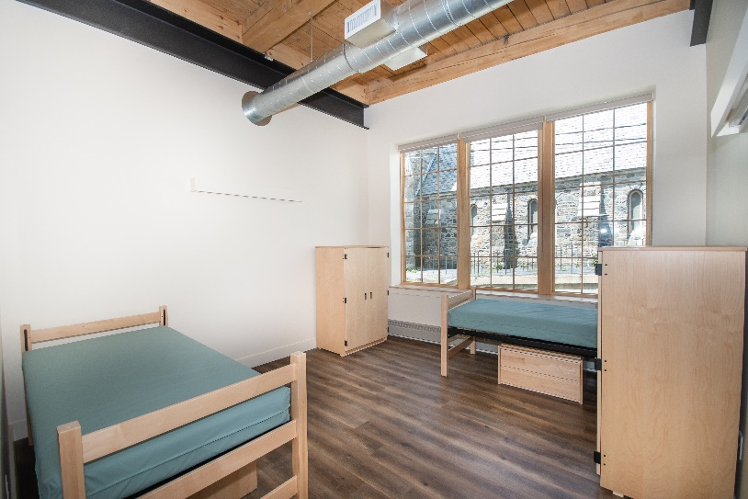
SUPPORTIVE HOUSING FOR PEOPLE WITH
SUBSTANCE USE DISORDERS
Residents are low- to moderate-income and in recovery from a Substance Use Disorder (SUD)
Eligible developers include non-profit and for-profit companies, municipalities, public housing authorities
Supportive services may be contracted; must be provided by an experienced SUD recovery organization
Different models of SUD supportive housing
NH Housing strongly encourages SUD supportive housing projects to obtain certification through the NH Coalition of Recovery Residences (NHCORR)
CLAREMONT: Sullivan House
28-bed transitional housing
for individuals exiting
Sullivan Co. DOC TRAILS program

Slide 10
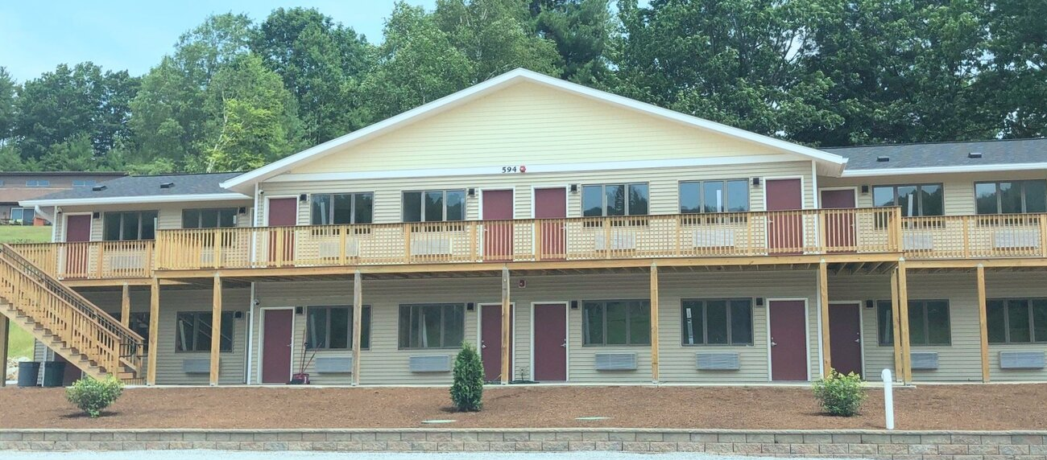
SUD HOUSING FINANCED BY NH HOUSING
BENNINGTON: Bridge Street Recovery
LACONIA: Compass House
KEENE: 106 Roxbury Street
MANCHESTER: Fit Recovery Housing
BETHLEHEM: Friendship House
KEENE: Live Free Sober Living
CLAREMONT: Sullivan House
BENNINGTON: Bridge Street Recovery
40-bed transitional housing
for individuals at
various stages of recovery

Slide 11


603-472-8623
info@nhhfa.org
NHHousing.org

