Slide 1
RADON LESSON 5th Grade

Slide 2
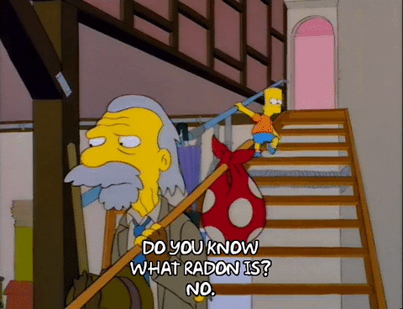
YOU WILL LEARN
What is Radon
How Radon is Formed
What is Radiation
How Radon Affects Your Health
How Radon Gets into Homes
What Causes Higher Radon Levels in Homes
How to Apply Bernoulli’s Principle
How to Test for Radon
How Radon is Measured
What to do if Your Home has High Radon Levels

Slide 3
WHAT IS RADON?
PART 1

Slide 4
WHAT IS RADON?
An odorless, invisible, tasteless, gas found in nature.
Builds up in many homes and buildings and can be a health hazard for you and your family.

Slide 5
HOW RADON IS FORMED?
URANIUM:
Is a radioactive element that was present when earth formed – and still exists today!
When uranium breaks down (decays) it forms radium.
When radium breaks down (decays) it forms radon.

Slide 6
PERIODIC TABLE OF ELEMENTS
Radon
Radium
Uranium

Slide 7
WHAT IS RADIATION?
Unstable atoms spontaneously change into different atoms.
When they change they emit radiation.

Slide 8
WHAT IS RADIATION?
Ionizing radiation is when atoms are physically changed by making them electrically charged.

Slide 9
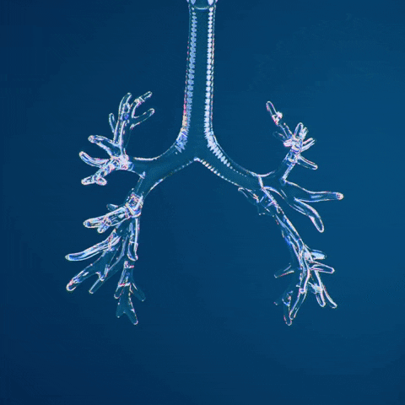
RADON & DNA DAMAGE

Slide 10
HOW RADON AFFECTS YOUR HEALTH
Radon decay products: BAD NEWS for our respiratory system.
When we breathe, radon decay products may become trapped in our lungs.
Radon can damage lung tissue cells and increase the risk of lung cancer.

Slide 11
HOW RADON AFFECTS YOUR HEALTH
Radon gas is inhaled and exhaled.
The half-life of radon is 3.8 days (Half life is the time required for half of the atoms to decay).
Radon decay products cling to dust particles in the air.
Radon decay products are inhaled into lungs and remain stuck to tissue.
As Radon breaks down it emits radiation.
Alpha particles strike cells causing physical and/or chemical damage to DNA.

Slide 12
RADON DECAY PRODUCT IN LUNGS

Slide 13
HOW RADON AFFECTS YOUR HEALTH
It is best to reduce exposure to radon.
Our risk of developing lung cancer from breathing radon depends on two factors:
The amount of radon in the air that we breathe; and
How long we breathe air containing radon decay products.

Slide 14
HOW RADON AFFECTS YOUR HEALTH
OTHER RADON FACTS:
Radon is the leading environmental cause of cancer mortality.
Radon kills about 21,000 people in the U.S. every year.
Radon is the leading cause of lung cancer in non-smokers.
Smokers exposed to radon double their risk of getting lung cancer.

Slide 15
Class Demonstration: Radon & Your Lungs
“Between a Rock and a Hard Place”
“Static Cling”

Slide 16
RADON IN THE HOME PART 2

Slide 17
ACTIVITY: “AN UNINVITED GUEST”

Slide 18
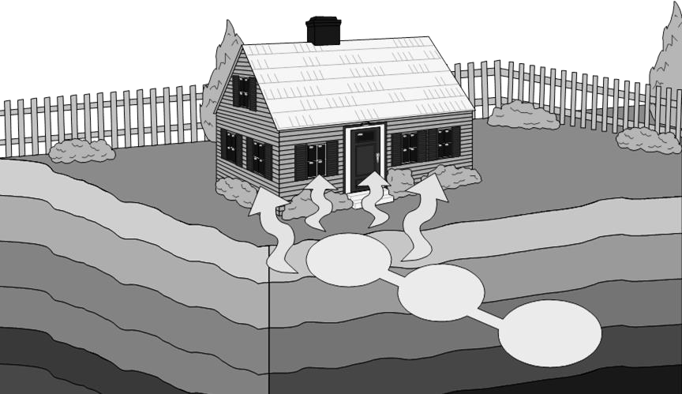
HOW RADON GETS INTO HOMES
Radon
Radium
Uranium

Slide 19
HOW RADON GETS INTO HOMES
First, it travels in small spaces in soil and rock under our homes.
Then, it gets drawn into a home through dirt floors, crawl spaces, cracks and pores in floors and walls.

Slide 20
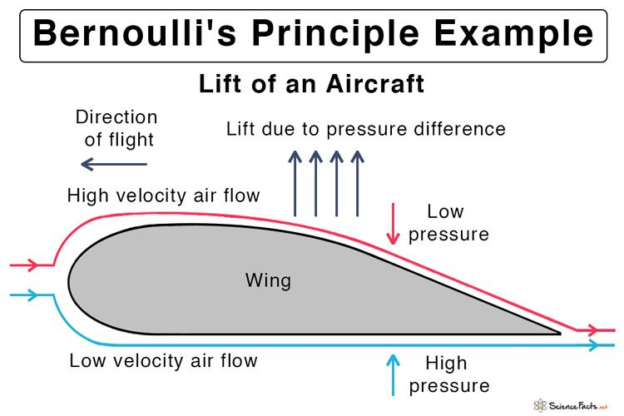
HOW RADON GETS INTO HOMES
Fast airflow results in a low pressure area.
Slow airflow results in a high pressure area.
Higher pressure under an airfoil causes lift.
Image source: https://www.sciencefacts.net/bernoullis-principle-and-equation.html

Slide 21
Pressure differences are created around a house.
WHAT CAUSES HIGHER RADON LEVELS IN HOMES
Radon moves from high pressure to low pressure.

Slide 22
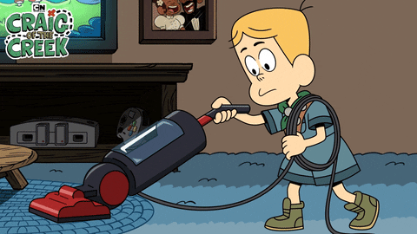
WHAT CAUSES HIGHER RADON LEVELS IN HOMES
A home acts like a vacuum drawing radon inside.

Slide 23
WHAT CAUSES HIGHER RADON LEVELS IN HOMES
Weather Factors:
High Winds
Rain
Warmer indoor temperatures than outside

Slide 24
WHAT CAUSES HIGHER RADON LEVELS IN HOMES
Radon moves from high pressure area to a low pressure area.

Slide 25
WHAT CAUSES HIGHER RADON LEVELS IN HOMES
Rain fills the spaces and “caps” the radon from escaping the exposed soil, but radon will move to the dry spaces underneath the house.

Slide 26
Radon moves from high pressure area to a low pressure area.
WHAT CAUSES HIGHER RADON LEVELS IN HOMES
Heating systems raise indoor air temperatures.

Slide 27
WHAT CAUSES HIGHER RADON LEVELS IN HOMES
Building Design Factors:
Air flow through vents and chimney
Activities Within Building:
Central forced air systems
Combustion appliances
Exhaust fans
Result in lower pressure inside.

Slide 28
ACTIVITY: “CHEERS OR NO CHEERS?”

Slide 29
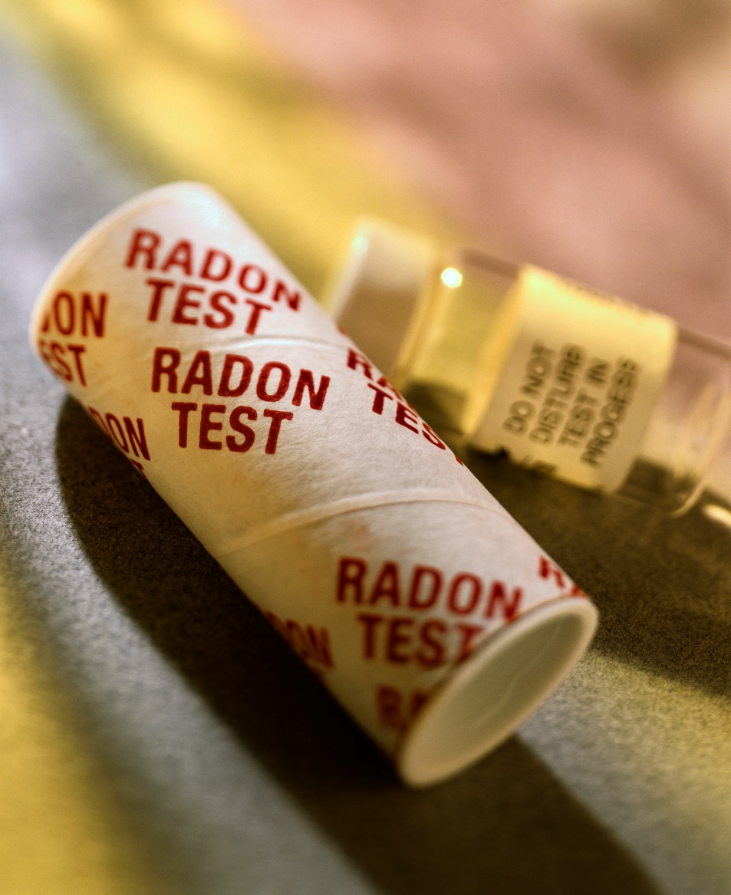
RADON TESTING
PART 3

Slide 30
HOW TO TEST FOR RADON
Charcoal Radon
Detection Devices
Short-term tests
Low cost
Easy to use
Found in most hardware stores

Slide 31
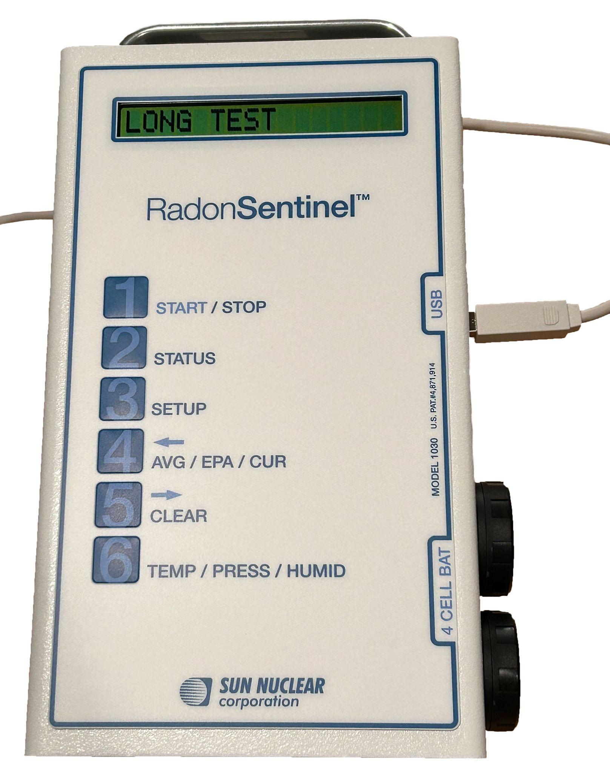
HOW TO TEST FOR RADON
Continuous Radon Monitor:
Provides a better year round average of radon levels.
91 days -1 year.

Slide 32
HOW RADON IS MEASURED
Picocuries per liter of air (pCi/L).
EPA action level is 4.0 pCi/L or more.
No level of radon is safe.

Slide 33
WHAT TO DO IF YOUR HOME HAS HIGH RADON LEVELS
Not all homes or buildings have the same radon level.
One home may have a low level while the home next door may have a high level.

Slide 34
Testing Is The Only Way To Know
100 pCi/L
1,25 pCi/L
25 pCi/L
???

Slide 35
DON’T PANIC…
Even very high radon levels can be reduced!

Slide 36
WHAT TO DO IF YOUR HOME HAS HIGH RADON LEVELS
A “radon mitigator” is trained to lower radon levels in homes and buildings.
A radon mitigation system may include:
Plastic pipe extending from basement to above the roof.
Fan to suck the radon from the ground, into the pipe, and out into the air above the roof.
Colorado Department of Public Health: infographic (2018). Is Your Home Safe from Radon. [PDF]

Slide 37
ACTIVITY: THE WORST AND THE BEST CASE SCENARIOS
Based on Bernoulli’s Principle…
Which locations may have the worst (highest) radon levels at school?
Which locations may have the best (lowest) radon levels at school?

Slide 38
ACTIVITY: “THE ONLY WAY TO KNOW” HOME RADON TEST
“The Only Way To Know” Home Radon Test
Test Kit Serial # | Prediction (Above, at or below 4pCi/L action level, and why) | Environmental Observations (external & internal variables over duration of test) | Actual Test Results (pCi/L) | Inferences (Variables that may impact reliability of test)

Slide 39
THIS PRESENTATION WAS ADAPTED FROM THE FOLLOWING RESOURCES
Connecticut Department of Public Health, Mrs. Sullivan: radon lesson (no date). Radon Lesson. [PowerPoint presentation]
DESP 3R’s: teacher resource (no date). Unit 3: What is Radon? [Word document]
EPA: radon overview (no date). Education Outreach packet. [powerpoint presentation]
Utah Department of Environmental Quality, Eleanor Divver: radiology lesson (no date). Radiological Basics. [PowerPoint presentation]

Slide 40
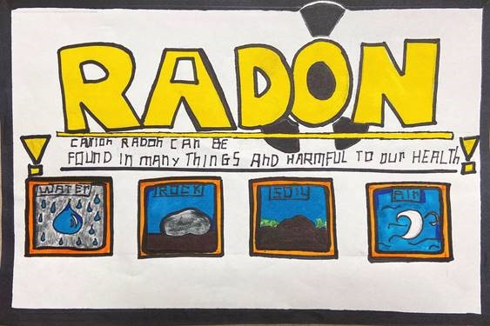
RADON POSTER CONTEST PART 4
2021 NH Radon Poster Contest Winner

Slide 41
POSSIBLE POSTER TOPICS:
Choose ONE topic to focus on from the list below …
What is radon?
Where does radon come from?
How does radon get into our homes?
Radon can cause lung cancer.
Test your home for radon.

Slide 42
ARTWORK REQUIREMENTS
No student names on front
Include a title and topic on the front
Use paper provided and fill out the Artwork Submission Form
Create with markers, crayons, paint, collage, pencil, photographs, or computer graphics
Do not use copyrighted characters, logos, or brand names
Message should be large, readable, and easily reproduced
One-inch (1”) margin

Slide 43
PRIZES
1st Place
$100 prize for grades 5-6
$100 prize for grades 7-8
$100 prize for each winning classroom
2nd Place
$75 prize for grades 5-6
$75 prize for grades 7-8
$100 prize for each winning classroom
3rd Place
$50 prize for grades 5-6
$50 prize for grades 7-8
$100 prize for each winning classroom

