Slide 1
Preventive Health and Health Services Block Grant (PHHSBG)
DRAFT

Slide 2
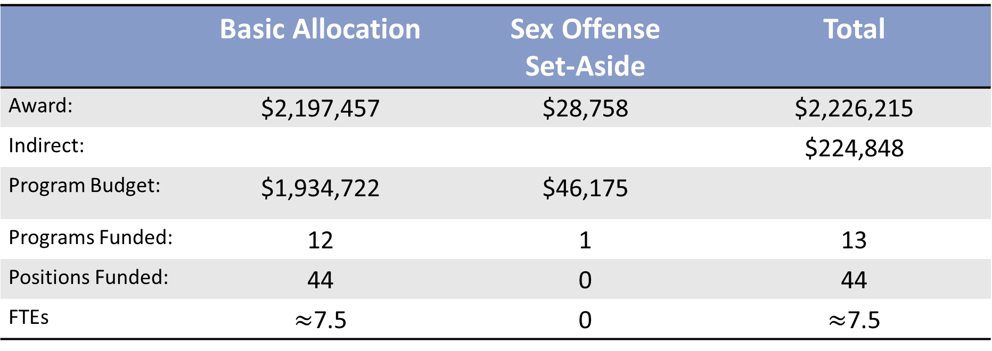
Budget at a glance
 | Basic Allocation | Sex Offense Set-Aside | Total
Award: | $2,197,457 | $28,758 | $2,226,215
Indirect: |  |  | $224,848
Program Budget: | $1,934,722 | $46,175
Programs Funded: | 12 | 1 | 13
Positions Funded: | 44 | 0 | 44
FTEs | $≈$7.5 | 0 | $≈$7.5

Slide 3
Major Impact:
Absorption of salary increases across 7.5 FTEs
Personnel first
Funding shifts

Slide 4
Program | Funding | Purpose
Rabies Testing | $273,397 | Personnel and supplies
Paralytics Shellfish Poisoning
Tuberculosis Testing
Health Officer Liaison | $118,888 | Personnel and membership
Food Safety | $53,337 | Personnel

Slide 5
Program | Funding | Purpose
Data Portal | $177,000 | Personnel and contract Abacus
Behavioral Risk Factor Surveillance System | $224,848 | Contract Macro
State Health Improvement Plan | $269,848 | Personnel and contract UNH
Public Health Advisory Councils (CHA-CHIPS) | $195,000 | Contracts Public Health Networks
Sexual Violence Prevention | $46,175 | Contract NHCADSV

Slide 6
Program | Funding | Purpose
Cancer Registry | $96,800 | Contract Dartmouth
School Sealant Programs | $358,060 | Contract
Tuberculosis, Hep A, and Pertussis Containment and 24/7/365 Nurse Coverage | $258,458 | Personnel and contracts

Slide 7
Public Health Lab
Test 100% of rabies specimens with direct fluorescent antibody or PCR method within 24 hours of receipt
Test 100% of shellfish samples within 24 hours using High-Performance Liquid Chromatography (HPLC) method
Provide rapid laboratory tests for Tuberculosis samples within 48 hours of receipt using nucleic acid amplification

Slide 8
Health Officer Liaison
Provide education and technical assistance services to appointed health officers
Maintain current contact and emergency response information for all health officers, deputy health officers, and town officials

Slide 9
Food Safety
Identify establishments with repeated violations and deliver technical assistance and training to prevent recurrence

Slide 10
Data
Create new or improve existing dashboards for Data Portal
Collect interviews for the Behavioral Risk Factor Surveillance System

Slide 11
SHA-SHIP and CHA-CHIPs
Create and launch the State Health Improvement Plan
Create alignment between the SHA-SHIP and CHA-CHIPs
Provide a standardized dataset to each region on a yearly basis to more easily understand priority health challenges

Slide 12
Sexual Violence Prevention
Provide sexual violence prevention education
Provision of sexual/domestic violence crisis intervention services

Slide 13
Cancer Registry
Maintain cancer registry that meets CDC National Data Quality & Advanced Data Quality Standards

Slide 14
School Sealant Programs
Provide oral health screenings and preventative oral health treatment to elementary and middle school aged children who otherwise would not have access

Slide 15
Bureau of Infectious Disease Control
Contact tracing and investigation for prevention of secondary Hepatitis A infections
Conduct investigations for suspicion of pertussis to decrease spread in children under 1 year
Investigation of clusters/outbreaks of gastrointestinal illness
Management of active Tuberculosis cases and high risk refugees

