Slide 1
State of New Hampshire Department of Health and Human Services Request for Information (RF) for Hampstead Hospital Administration
DHHS Office of the Commissioner and Bureau of Contracts & Procurement
July 20, 2022
Morissa Henn – Associate Commissioner
Rebecca Ross - Director Bureau for Children’s Behavioral Health
Brooke Provost – Administrator III

Slide 2
Disclaimer
This presentation includes brief descriptions of the RFI specifications and requirements, but does not fully elaborate on all required elements. As a result, this presentation does not supersede what is stated in the RFI or its appendices.
While questions may be asked during this presentation, the Department is not obligated to answer questions during the presentation. As indicated in the RFI, any questions answered verbally will be non-binding. Questions provided in writing in accordance with the RFI will be answered, in writing, by the Department.
This RFI is for informational purposes only, and is not intended to result in a contract or vendor agreement with any respondent. This RFI is not a Request for Proposals, Bids, or Applications. The State is seeking vendor community insight and information prior to finalizing business, functional, operational, and technical requirements before considering the publishing of a Request for Proposal (RFP).
This RFI does not commit the State to publish an RFP or award a contract.
Notes:
Brooke - Ground rules – We will have a Q&A period, in which we will go through the sections of the RFI. all questions in the chat received prior to the QA period will be reviewed at that time during this call , if questions are received after the Q&A periods on this call , they will be reviewed at the end of the call.
stay muted until the Q&A periods.
All information associated with this RFI is considered confidential and we and they are unable to discuss with anyone

Slide 3
Agenda
Welcome and Meeting Overview
Background and Purpose
Vision
Q & A – Review of RFI
Overview of proposal
Next steps
Notes:
Brooke

Slide 4
Background
In 2019, the New Hampshire 10-Year Mental Health Plan was developed and approved, which supports the need for a robust system of inpatient and residential treatment to enhance the continuum of care for mental health treatment.
In June 2022, the State of New Hampshire purchased Hampstead Hospital—now named Hampstead Hospital and Residential Treatment Facility (HHRTF).
The Department entered into an agreement with a contractor for the provision of child and young adult psychiatric behavioral health services for a period of approximately two (2) years
Department is responsible for developing the overall strategic vision for HHRTF, which is a key component of NH’s Children’s System of Care.
Notes:
Morissa

Slide 5
Vision
The Department must provide high-quality, cost-effective, accessible inpatient behavioral health services for children (ages 5-17) and young adults (ages 18-25).
For inpatient and residential care, the Department envisions a system in which all children requiring residential treatment receive tailored services that rapidly stabilize their behaviors, treat their symptoms, and promptly return them to family-based settings.
Notes:
Rebecca

Slide 6
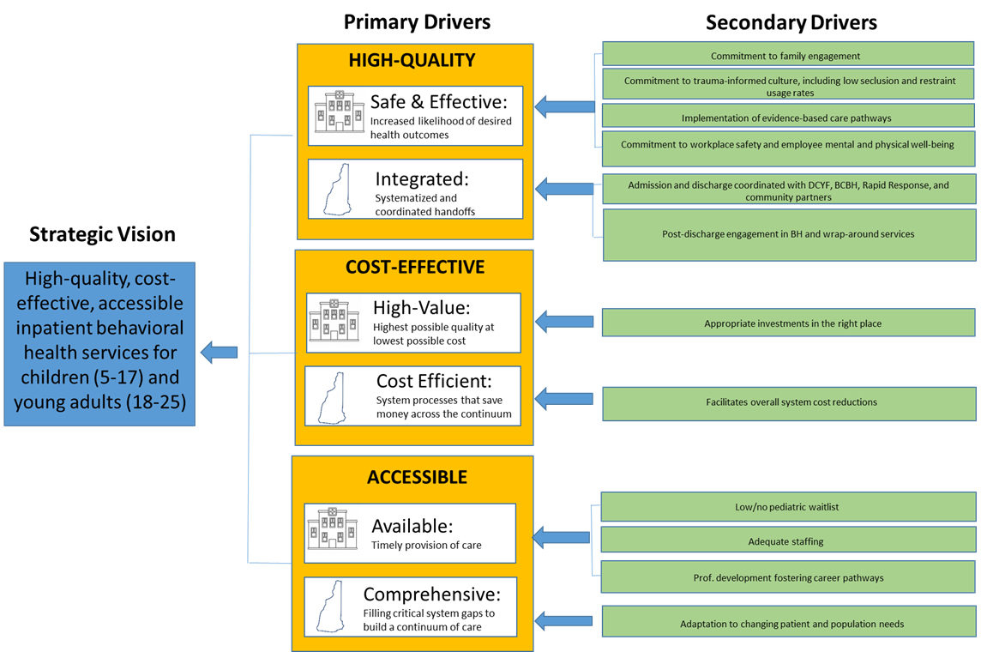
Vision
Notes:
Rebecca

Slide 7
Goals of RFI
Department is seeking stakeholder input on future vision for HHRTF.
Goal is to enhance the current service array and service delivery through the design of an efficient and effective operational model;
Review various operational methods.
Review recommendations on the long-term strategy and direction of the facility
Best methods, if applicable, for structuring a contract that provides outstanding care for individual patients.
Notes:
Morissa

Slide 8
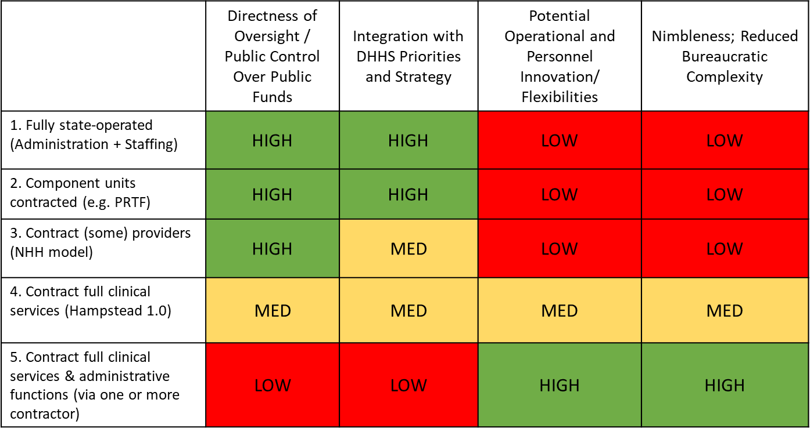
Operational Models
Notes:
Morissa

Slide 9
Hampstead Hospital Administration RFI
Notes:
Brooke to bring up RFI document

Slide 10
Proposal Overview: General Content
Transmittal cover letter Table of Contents – Optional Answers to questions – not required to respond to all questions.
Notes:
The content of each Proposal will become public information once the Governor and Executive Council have approved a contract. Any information submitted as part of a Proposal in response to this RFP may be subject to public disclosure under RSA 91-A. The Proposer is strongly encouraged to provide a redacted copy of their Proposal.

Slide 11
How to Submit
Proposals must be submitted electronically to this email: Brooke.L.Provost@dhhs.nh.gov and DHHS-Contracts@dhhs.nh.gov
The subject line of your email must include the RFI ID (RFI) RFI-2023-HH-01-HAMPS
If you plan to submit with multiple emails, please number your emails (e.g., RFI 1 of 5)
As a reminder, the maximum size of files per email is 10MB, meaning you will likely need to send multiple emails or use a zip folder
For those who haven’t used zip folders: Right click on the desktop, select new, select zip folder, name the folder, and drop your contents in
Submissions
Notes:
Brooke

Slide 12
Next Steps
Procurement Timetable
Item | Action | Date
1. | Release RFI | July 5, 2022
2. | Vendors Conference | July 20, 2022 at 12:00PM
3. | Vendor Questions Due | July 22, 2022 at 12:00PM
4. | Department’s answers to Vendor questions posted | August 10, 2022
5. | RFI Responses due | August 24, 2022 at 12:00PM
All times are according to Eastern Time. The Department reserves the right to modify these dates at its sole discretion.
Notes:
Brooke

Slide 13
Next Steps – Post Proposal Submission
Next steps determined
RFI's reviewed
Decision Period
Notes:
Brooke

Slide 14
Hampstead Hospital Administration RFI
Thank You
Be sure to email:
Brooke.L.Provost@dhhs.nh.gov
with any questions by
July 22, 2022 at 12:00PM
Notes:
CHECK CHAT FOR ADDITIONAL QUESTIONS.
THANK YOUS
Q’S DUE THURSDAY 7/22 12PM ALL COMMUNICATION MUST GO TO BP

